Slide 1
Entrepreneurship Development
Develop the Solution Demo
Build solution (mockups) demo, how to run solution interviews, GOOTB: Run Solution
interviews.
Does your solution solve the problem for your customers: The problem-solution test?
Sizing the Opportunity
Differences between a Startup venture and a small business; Industry Analysis
Understanding what Competition is and its role, Analyze competition
Case study: Blue Ocean Strategy
Building an MVP
Identify an MVP and build it - I; Document and validate your assumptions
Build-Measure-Learn feedback loop and the MVP/Javelin Board
How to do MVP Interviews
GOOTB: Run MVP interviews
Is there a market for your product --The product-market fit test

Slide 2
Validation
Develop the solution demo - build solutions Mockups demo as a part of validation entrepreneurship development
Creating a solutions mockup demo is an essential part of validating entrepreneurship development.
This process helps you visualize and communicate your business concept effectively to potential stakeholders, partners, and investors

Slide 3
Step-by-Step guide to developing a mockup demo
1. Define Your Problem Statement:
Clearly articulate the problem your solution aims to address.
Understand your target audience and their pain points.
2. Research and Ideation:
Research your target market to gather insights and understand the competition.
Brainstorm potential solutions and features that address the problem
3. Create a Value Proposition:
Define a compelling value proposition that highlights the unique benefits of your solution.
4. Sketch Your Solution:
Start with rough sketches on paper to visualize the user interface and user experience.
Focus on key screens and functionalities.
5. Choose the Right Tools:
Select design and mockup tools such as Figma, Sketch, Adobe XD, or even pen and paper.

Slide 4
Step-by-Step guide to developing a mockup demo
6. Create Wireframes:
Develop wireframes that represent the layout and structure of your solution.
Ensure that wireframes are easy to understand and navigate.
7. Design High-Fidelity Mockups:
Once wireframes are approved, move on to designing high-fidelity mockups.
Pay attention to colors, typography, and detailed design elements.
8. Prototype Your Solution:
Use your high-fidelity mockups to create interactive prototypes.
Prototypes help users navigate your solution as if it were a real product.
9. Test Your Mockup:
Conduct usability testing with potential users to gather feedback.
Make improvements based on user feedback.
10. Create a Pitch Presentation:
Develop a compelling pitch presentation that explains your solution.
Include mockup images, user scenarios, and market research.
11. Build a Landing Page or Website:
Develop a simple landing page or website that showcases your mockup and provides information about your solution.

Slide 5
Step-by-Step guide to developing a mockup demo
12. Validate Your Solution:
Share your mockup demo with potential users, partners, and investors.
Gather feedback, analyze the response, and make necessary adjustments.
13. Iterate and Refine:
Use feedback to iterate and refine your mockup demo.
Continue testing and improving your solution's mockup until you are confident in its viability.
14. Document the Process:
Keep detailed records of the development process, user feedback, and changes made.
15. Develop a Business Plan:
Use the validated mockup demo as a foundation for your business plan.
Include details on how you plan to develop the actual product and scale your business.
16. Seek Funding and Partnerships:
With a validated mockup demo and a solid business plan, approach potential investors, accelerators, and strategic partners.
17. Maintain Engagement:
Continue engaging with your target audience and gathering feedback even after securing funding or partnerships.

Slide 6
Step-by-Step guide to developing a mockup demo
Natural causes: Human beings have little control over natural calamities like flood, earthquake, lightning, heavy rains, famine etc.
Human causes: include such unexpected events like dishonesty, carelessness or negligence of employees, stoppage of work due to power failure, strikes, riots, managements inefficiency etc.
Economic causes: include uncertainties relating to demand for goods, competition, price , collection of dues from customers, changes of technology or method of production etc.
Other causes: These are unforeseen events like political disturbances (JK), mechanical failure such as the bursting of boiler, fluctuations in exchange rates, etc., which leads to the responsibility of business risk.

Slide 7
Run solution interviews
Running solution interviews is a key step in validating your business idea or product concept. These interviews involve discussing your proposed solution with potential customers or users to gather feedback, insights, and validate whether your solution addresses their needs and pain points. Here's how to conduct solution interviews effectively:
1. Identify Your Target Audience:
Define the specific segment of potential customers or users that you want to target. Understand their demographics, behaviors, and preferences.
2. Create an Interview Plan:
Develop a structured plan for your interviews, including objectives, a list of participants, questions, and a timeline.
3. Develop an Interview Script:
Create a set of open-ended questions to guide your interviews. These questions should encourage participants to express their thoughts, needs, and experiences related to the problem your solution aims to solve.
4. Find Participants:
Reach out to individuals who match your target audience. You can find participants through personal contacts, social media, online forums, or by attending relevant events.
5. Conduct the Interviews:
Schedule interviews with participants, either in person, over the phone, or via video conferencing, based on your convenience and the participants' availability.

Slide 8
6. Introduce Your Solution:
Present your solution and explain how it can address the problems or challenges they've described. Be concise and clear about your solution's key features and benefits.
7. Ask for Feedback
Encourage participants to provide honest and detailed feedback on your solution. Pose questions like:
"What are your thoughts on our solution's approach to addressing this problem?"
"Do you see any potential issues or limitations with our solution?"
"How does our solution compare to your current alternatives?"
8. Record and Analyze Responses:
Document participants' responses and feedback during the interviews. Look for common themes, recurring pain points, and suggestions for improvement.
9. Maintain Objectivity:
Be objective and avoid leading participants toward favorable responses. You want to uncover their genuine thoughts and feelings.
10. Iterate and Improve:
Use the feedback to make iterative improvements to your solution. Address identified pain points, incorporate valuable suggestions, and refine your solution based on user input.

Slide 9
11. Validate Your Solution:
After making improvements, revisit participants or new interviewees and ask if the changes effectively address their concerns and needs.
12. Maintain an Ongoing Feedback Loop:
Continue to engage with potential and existing customers to ensure your solution continues to meet their evolving needs and expectations.
13. Make Data-Driven Decisions:
Use the insights gained from solution interviews to make informed decisions about your product or service, pricing, marketing, and overall strategy.
Solution interviews are a crucial part of the customer development process, allowing you to validate your solution and make necessary adjustments to increase its chances of success in the market. Listening to your potential customers and iterating based on their feedback is a key principle in entrepreneurial success.

Slide 10
Does your solution solve the problem for your customers?
To determine whether your solution effectively solves the problem for your customers, you need to conduct thorough customer validation and gather feedback. This is a critical step in the development and success of any product or service. Here's how to assess whether your solution addresses your customers' needs:
Conduct Customer Interviews: Engage with your target audience through customer interviews. Ask open-ended questions to understand their pain points, challenges, and needs. These interviews help you gather insights into the specific problems your customers are facing.
Introduce Your Solution: After identifying their pain points, present your solution and explain how it can address the issues they've mentioned. Be clear and concise about the key features and benefits of your solution.

Slide 11
Gather Feedback: Encourage customers to provide honest and detailed feedback about your solution. Ask for their opinions, concerns, and suggestions for improvement. Be prepared to receive both positive and negative feedback.
Observe User Behavior: If your solution is already in use, analyze user behavior and engagement. Metrics like user adoption rates, retention, and user satisfaction surveys can provide valuable insights into whether your solution is solving the problem.
Iterate and Improve: Use the feedback and data you collect to make iterative improvements to your solution. Address identified pain points, enhance features, and refine your product or service based on user input.

Slide 12
Validate Through Testing: Implement A/B testing, split testing, or other methods to compare the performance of your solution with variations. These tests can help confirm whether your solution is more effective at addressing the problem than alternatives.
Measure Success Metrics: Define key performance indicators (KPIs) that will determine the success of your solution. These metrics may include user engagement, conversion rates, user satisfaction, and revenue. Regularly monitor these metrics to evaluate your solution's impact.
Pilot Testing: If possible, offer your solution as a limited release or pilot program to a subset of your target audience. Collect feedback and data during this phase to make necessary improvements before a full launch.

Slide 13
Seek Validation from Independent Sources: Consider third-party assessments, reviews, or endorsements. Independent validation can provide added credibility and assurance to potential customers.
Continuous Feedback Loop: Maintain an ongoing feedback loop with your customer base. Stay engaged with them and seek feedback as you make updates and enhancements to your solution.
Adapt and Pivot if Necessary: If your solution consistently fails to address your customers' problems or if the feedback suggests a fundamental issue, be open to pivoting or making significant changes to your offering.

Slide 14
The problem solution test
Testing your problem solution is a critical part of the entrepreneurial process. To effectively test your problem solution, you'll want to follow these steps:
1. Define Success Metrics:
Clearly outline the key performance indicators (KPIs) that will determine the success of your solution. These metrics may include user engagement, conversion rates, user satisfaction, revenue, or any other relevant criteria.
2. Create a Testing Plan:
Develop a structured plan that outlines how you intend to test your problem solution. Identify the target audience, testing methods, and a timeline for the testing phase.
3. Choose Testing Methods:
There are various methods to test your problem solution. Here are a few common approaches:
User Testing: Have potential users interact with your solution and gather feedback on their experiences.
A/B Testing: Compare different variations of your solution to see which one performs better.
Surveys and Questionnaires: Collect user opinions and preferences through surveys.
Focus Groups: Conduct group discussions with potential users to gain insights.
Prototype Testing: Test early versions of your solution to identify design and usability issues.

Slide 15
The problem solution test
4. Conduct User Interviews:
Interview potential users to understand their pain points and gather their input on your solution. Ask for their feedback and suggestions for improvement.
5. Run A/B Tests:
If applicable, perform A/B tests to compare different versions or features of your solution to see which one resonates best with users.
6. Collect Feedback:
Encourage users to provide feedback through various channels, such as email, in-app feedback forms, or surveys. Analyze this feedback to identify areas for improvement.
7. Monitor Analytics:
Implement analytics tools to track user behavior and engagement with your solution. Analyze the data to gain insights into how users are using your product and where they might be encountering issues.
8. Iteration and Improvement:
Based on the feedback and data you collect, make iterative improvements to your solution. Focus on resolving identified pain points and enhancing user satisfaction.

Slide 16
The problem solution test
9. Validate the Market:
Test your solution in the market to see if it addresses a real need and if users are willing to pay for it. Consider offering your solution as a limited release or in a closed beta to validate demand.
10. Monitor Competition:
Keep an eye on your competitors and how they are addressing similar problems. Use this information to refine your solution and maintain a competitive edge.
11. Pivot if Necessary:
If testing reveals that your initial problem solution is not gaining traction or satisfying users, be open to pivoting. Adjust your solution based on the feedback and market dynamics.
12. Scale and Expand:
Once your problem solution has been tested and refined, develop a strategy for scaling and expanding your business. Seek additional funding and marketing efforts to reach a wider audience.
The testing phase is an ongoing process in entrepreneurship. Regularly assess your solution and be ready to adapt to changing circumstances and user needs. Ultimately, the success of your problem solution depends on your ability to listen to feedback, iterate, and consistently deliver value to your target audience.

Slide 17
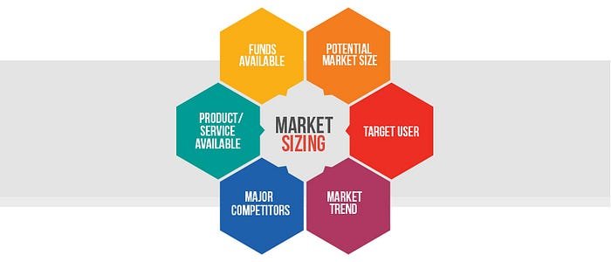
Sizing the opportunity in entrepreneurship

Slide 18
Sizing the opportunity in entrepreneurship
Sizing the opportunity in entrepreneurship involves evaluating the potential market for your business idea to determine its attractiveness, profitability, and feasibility. This is a critical step in the business planning process. Here's how to go about it:
1. Market Research:
Start with comprehensive market research. Gather data on the industry, target market, and the specific problem or need your business aims to address. Use both primary (surveys, interviews) and secondary (industry reports, market data) research methods.
2. Define Your Target Audience:
Identify your ideal customers. Create detailed customer personas to understand their demographics, behaviors, preferences, and pain points.

Slide 19
3. Market Size and Growth:
Estimate the total addressable market (TAM), which is the maximum potential market for your product or service. Then, narrow it down to your serviceable, or obtainable, market (SAM) and your target market (SOM). Research market growth trends to understand if your target market is expanding.
4. Competitive Analysis:
Analyze the competition in your target market. Identify key players, their market share, strengths, weaknesses, and their strategies. Determine where your business fits in this competitive landscape.
5. Market Trends:
Explore current and future trends in the industry. Are there emerging technologies, consumer preferences, or regulatory changes that may affect your opportunity?

Slide 20
6. Customer Segmentation:
Break down your target market into segments with similar characteristics and needs. Determine which segments are most likely to adopt your solution.
7. Customer Validation:
Conduct surveys, interviews, or pilot studies to validate that there is a real demand for your product or service. Get feedback from potential customers to understand their pain points and whether your solution addresses them.
8. Pricing Strategy:
Determine the optimal pricing strategy for your product or service. This should be based on a combination of production costs, competitor pricing, and what your target market is willing to pay.
9. Sales and Distribution Channels:
Plan how you will reach your target customers. Identify the most effective sales and distribution channels for your business, whether it's direct sales, online sales, retail partnerships, or other methods.
10. Financial Projections:
Develop financial projections based on your market research. Estimate revenue, expenses, and profitability over the short-term and long-term. Include factors like seasonality, customer acquisition costs, and customer lifetime value

Slide 21
11. Risk Assessment:
Identify potential risks and challenges associated with your business opportunity. Evaluate how these risks might affect the size and viability of the opportunity.
12. Business Model Validation:
Validate your business model by testing your value proposition, pricing, and distribution strategy through real-world experiments or pilot programs.
13. Pivot or Iterate:
Be prepared to pivot or iterate your business idea based on the insights gathered during your opportunity sizing process. Your initial idea may evolve as you gain a deeper understanding of the market.
14. Document Your Findings:
Document all your findings and market analysis in a well-structured business plan. This will be valuable not only for your own decision-making but also for attracting investors and stakeholders.
Sizing the opportunity in entrepreneurship is a dynamic and ongoing process. It involves continuous monitoring of market dynamics, customer needs, and industry trends. A well-researched and properly sized opportunity will increase your chances of building a successful and sustainable business.

Slide 22

Startup Vs Small Business

Slide 23
Facebook
Twitter
LinkedIn
Pinterest
WhatsApp

Slide 24
A startup is a new buzzword in the corporate world. Almost every entrepreneur who starts a new business calls his/her venture a startup.
But not every business is a startup.
Many entrepreneurs realize later that their business was nothing but a small business from the very start.
This creates a confusion of what exactly is a startup and how is it different from a small business.

Slide 25
What is a Startup
A startup is a business structure powered by disruptive innovation, created to solve a problem by delivering a new product or service under conditions of extreme uncertainty. For example – Headspace, Duolingo, etc.
Precisely, it’s a business structure that has the following characteristics
Growth: Startup is a business structure designed to grow fast. According to Paul Graham, founder of Y Combinator, “A startup is a company designed to grow fast. Being newly founded does not in itself make a company a startup. Nor is it necessary for a startup to work on technology, or take venture funding, or have some sort of “exit.” The only essential thing is growth. Everything else we associate with startups follows from growth.”

Slide 26
Business Model: Startups are known to have unconventional business models. This is because they venture into an untapped market or fulfil repressed demands of the market.
Innovation: The mark of a true startup is disruptive innovation. Startups create new offerings or innovate the existing ones. They might also disrupt the way an offering reaches to the consumer and develop a new market for themselves.
Uncertain Environment: Startups operate in a highly uncertain environment. The possibility of failure always hangs around an entrepreneur’s neck.
Any business structure that does not possess these four characteristics is not a startup.

Slide 27
What is a Small Business
A small business is a privately owned corporation, partnership, or sole proprietorship that requires less capital, less workforce, and little to no machinery. These businesses operate on a small scale to serve a local community and generate less annual revenue than a large corporation. For example, local grocery stores, hair salons, car garages, cafes, etc
Usually, a small business possesses the following characteristics –
Limited Investment: Owners or a small group of individuals supply most of the capital requirements of the business. Since the scale of operations is small, the capital requirement is less.
Labor-Intensive: Small businesses usually don’t require heavy or sophisticated machinery. It uses more labor-intensive techniques.

Slide 28
Less Number of Employees: Small businesses employ a smaller number of employees as compared to large corporations. This is mainly due to their small scale of operations.
Local Area of Operations: Businesses like groceries shop, bakeries, or hair salons are all small businesses. They operate locally and remain there for longer periods of time (years or maybe decades), this helps the businesses to build a strong relationship with local customers.
Management: In most cases, the owner is also the manager of the business, which helps in quick decision making.

Slide 29
The challenges of new startup
Starting a new business, while exciting, comes with a set of challenges that entrepreneurs must navigate. Here are some common challenges faced by new startups:
Limited Resources:
Financial Constraints: Limited funding can restrict operations and growth.
Personnel: A small team may face challenges in managing various aspects of the business.
Market Competition:
Established Competitors: Competing with established businesses in the market.
Differentiation: Standing out in a crowded market and differentiating the product or service.
Uncertain Market Demand:
Market Validation: Determining whether there's a demand for the product or service.
Pivoting: Adjusting business models based on customer feedback and market response.
Regulatory Compliance:
Navigating Regulations: Complying with industry-specific regulations and legal requirements.
Licenses and Permits: Obtaining necessary licenses and permits for operation.

Slide 30
The challenges of new startup
Building a Customer Base:
Customer Acquisition: Attracting and retaining the first set of customers.
Marketing: Developing effective marketing strategies on a limited budget.
Talent Acquisition and Retention:
Hiring Challenges: Attracting skilled and committed team members.
Employee Retention: Retaining talent in the face of competition.
Scaling Operations:
Scaling Efficiently: Managing growth without compromising quality.
Infrastructure: Ensuring the infrastructure can support increased demand.
Cash Flow Management:
Financial Planning: Balancing income and expenses for sustained operations.
Invoice Payment: Dealing with delayed payments from clients.
Technology Challenges:
Adopting Technology: Keeping up with the latest technology trends.
Cybersecurity: Protecting sensitive data from cyber threats.

Slide 31
The challenges of new startup
Adaptability:
Market Changes: Adapting to changes in market trends and consumer behavior.
Pivoting Strategy: Being open to adjusting the business model based on feedback and trends.
Building Brand Awareness:
Marketing Effectiveness: Establishing and promoting the brand in the market.
Brand Trust: Gaining the trust of customers in a competitive landscape.
Time Management:
Prioritization: Juggling multiple responsibilities and tasks.
Meeting Deadlines: Delivering products or services on time.
Legal Issues:
Intellectual Property: Protecting intellectual property through patents, trademarks, etc.
Contracts and Agreements: Ensuring legal agreements are clear and enforceable.
Customer Feedback:
Handling Feedback: Responding to both positive and negative customer feedback.
Iterative Improvement: Continuously improving the product or service based on customer input.

Slide 32
The challenges of new startup
Mental and Emotional Strain:
Stress and Pressure: Managing the stress and pressure that comes with entrepreneurship.
Work-Life Balance: Balancing work commitments with personal life.
Navigating these challenges requires resilience, strategic planning, and a willingness to adapt. Successful startups often find creative solutions and learn from both successes and setbacks.

Slide 33
Startup | Small Business
Intent : The intention behind a startup is to disrupt the market with a scalable and impactful business model. Innovation : Innovation is an essential part of startups as they always create a new unique offering or innovate an existing one. Business Model : Startups usually have unconventional business models that are new to the market. This puts a startup in a high-risk position. Growth Rate : Startups witness an exponential growth which is without any limits.The biggest example is Facebook. After its launch, it grew exponentially throughout the world. Source of Funding : Startups go through various rounds of equity funding. Their sources are angel investors, venture capitalists, corporates, etc. Revenue : A startup takes years to plan, collect funds, build a product, and execute. Therefore, it generates revenue in the later years. Technology : Startups are often tech-oriented. Usually, startups use technology to disrupt the market. | Intent : The sole intention of a small business’ owner is to be her/his own boss and secure a place in the local market. Innovation : Small businesses deal in offerings that already exist in the market. Business Model : Small businesses adopt a tried and tested business model which creates a less risky situation. Growth Rate : Small businesses grow slowly and steadily. Their purpose is to maintain a steady income; therefore, the growth rate stops after reaching a certain level of income. Source of Funding : Small businesses acquire funds only in the initial stages of the business. Once established, they are either revenue financed or take business loans. They don’t go through various rounds of equity funding like startups. Revenue : Small businesses make profits from the start since they operate on tried and tested business models, and provide offerings that already have a market. Technology : Small businesses use traditional methods or minimum use of technology. The technology used in these businesses tends to be simple.

Slide 34
Differences Between Startups And Small Businesses
Scale and Growth: Startups are typically focused on rapid growth and scaling their operations, aiming to disrupt existing markets or create new ones. Small businesses, on the other hand, are often focused on maintaining a stable and sustainable operation.
Innovation and Disruption: Startups are driven by innovative ideas and disruptive technologies, aiming to solve a unique problem or address an unmet need in the market. Small businesses often offer established products or services in a specific niche.
Funding and Investment: Startups often seek external funding from investors or venture capitalists to fuel their growth. Small businesses are often self-funded or rely on traditional financing methods like loans or personal savings.
Risk and Uncertainty: Startups operate in a highly uncertain environment, taking risks to pursue ambitious goals. Small businesses, while still facing risks, often have a more stable and predictable business model.
Scalability and Replicability: Startups aim to create scalable business models that can be replicated and expanded rapidly. Small businesses may focus on serving a specific local market and may not have plans for extensive scalability.
Time Horizon: Startups are typically built with a long-term vision and the goal of eventually becoming a large company or being acquired. Small businesses often have a more immediate focus on generating consistent profits and sustaining their operations.
Organizational Structure: Startups are often lean and agile, with a focus on experimentation and rapid decision-making. Small businesses tend to have a more defined organisational structure and may be more traditional in their operations.

Slide 35
Difference Between an Entrepreneur and a Small Business Owner
Entrepreneurs tend to take big risks, have big-picture visions, and want to make a difference.
Small business owners are often happy filling a need locally and supporting themselves.
We need both in the world to meet the needs of our communities.

Slide 36
Industry analysis
Industry analysis is a market assessment tool used by businesses and analysts to understand the competitive dynamics of an industry. It helps them get a sense of what is happening in an industry, e.g., demand-supply statistics, degree of competition within the industry, state of competition of the industry with other emerging industries, future prospects of the industry taking into account technological changes, credit system within the industry, and the influence of external factors on the industry.
Industry analysis, for an entrepreneur or a company, is a method that helps to understand a company’s position relative to other participants in the industry. It helps them to identify both the opportunities and threats coming their way and gives them a strong idea of the present and future scenario of the industry. The key to surviving in this ever-changing business environment is to understand the differences between yourself and your competitors in the industry and use it to your full advantage.

Slide 37
Types of industry analysis
There are three commonly used and important methods of performing industry analysis. The three methods are:
Competitive Forces Model (Porter’s 5 Forces)
Broad Factors Analysis (PEST Analysis)
SWOT Analysis

Slide 38
1 Competitive Forces Model (Porter’s 5 Forces)
One of the most famous models ever developed for industry analysis, famously known as Porter’s 5 Forces, was introduced by Michael Porter in his 1980 book “Competitive Strategy: Techniques for Analyzing Industries and Competitors.”
According to Porter, analysis of the five forces gives an accurate impression of the industry and makes analysis easier. In our Corporate & Business Strategy course, we cover these five forces and an additional force — power of complementary good/service providers.

Slide 39
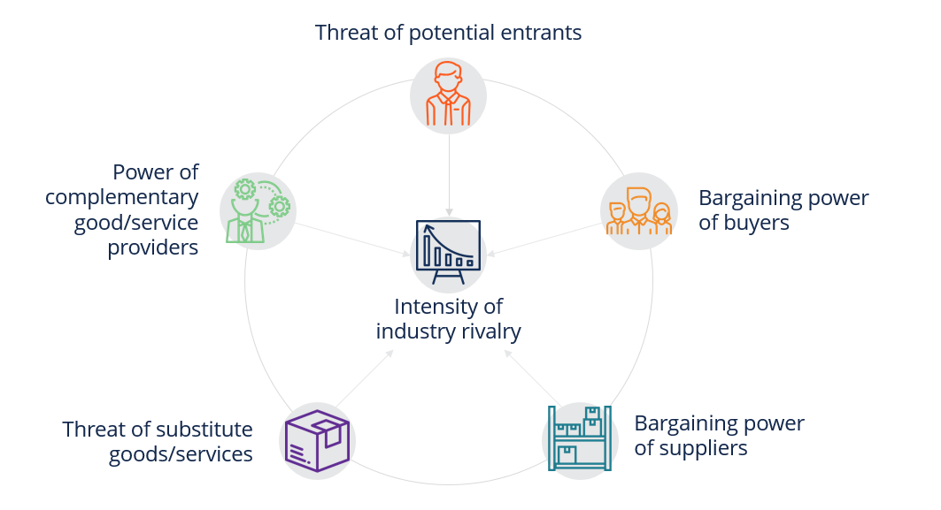

Slide 40
1. Intensity of industry rivalry
The number of participants in the industry and their respective market shares are a direct representation of the competitiveness of the industry. These are directly affected by all the factors mentioned above. Lack of differentiation in products tends to add to the intensity of competition. High exit costs such as high fixed assets, government restrictions, labor unions, etc. also make the competitors fight the battle a little harder.
2. Threat of potential entrants
This indicates the ease with which new firms can enter the market of a particular industry. If it is easy to enter an industry, companies face the constant risk of new competitors. If the entry is difficult, whichever company enjoys little competitive advantage reaps the benefits for a longer period. Also, under difficult entry circumstances, companies face a constant set of competitors.
3. Bargaining power of suppliers
This refers to the bargaining power of suppliers. If the industry relies on a small number of suppliers, they enjoy a considerable amount of bargaining power. This can particularly affect small businesses because it directly influences the quality and the price of the final product.
4. Bargaining power of buyers
The complete opposite happens when the bargaining power lies with the customers. If consumers/buyers enjoy market power, they are in a position to negotiate lower prices, better quality, or additional services and discounts. This is the case in an industry with more competitors but with a single buyer constituting a large share of the industry’s sales.
5. Threat of substitute goods/services
The industry is always competing with another industry producing a similar substitute product. Hence, all firms in an industry have potential competitors from other industries. This takes a toll on their profitability because they are unable to charge exorbitant prices. Substitutes can take two forms – products with the same function/quality but lesser price, or products of the same price but of better quality or providing more utility.

Slide 41
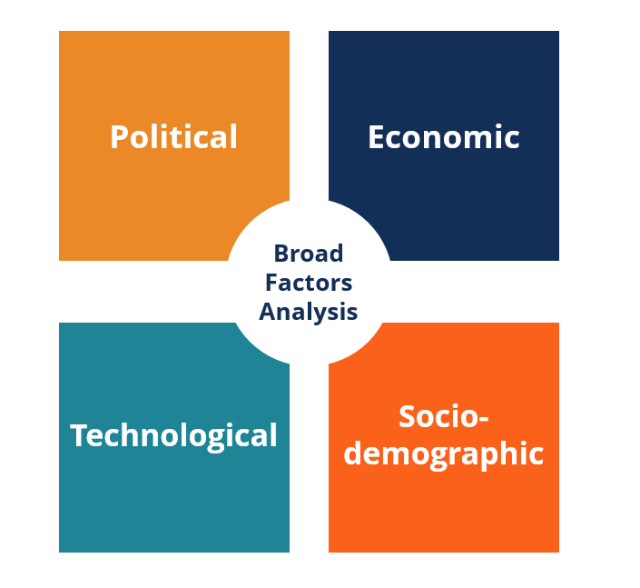
Broad Factors Analysis (PEST Analysis)
Broad Factors Analysis, also commonly called the PEST Analysis stands for Political, Economic, Social and Technological. PEST analysis is a useful framework for analyzing the external environment.

Slide 42
Broad Factors Analysis (PEST Analysis)
To use PEST as a form of industry analysis, an analyst will analyze each of the 4 components of the model. These componentsinclude:
1. Political
Political factors that impact an industry include specific policies and regulations related to things like taxes, environmental regulation, tariffs, trade policies, labor laws, ease of doing business, and overall political stability.
2. Economic
The economic forces that have an impact include inflation, exchange rates (FX), interest rates, GDP growth rates, conditions in the capital markets (ability to access capital), etc.
3. Social
The social impact on an industry refers to trends among people and includes things such as population growth, demographics (age, gender, etc.), and trends in behavior such as health, fashion, and social movements.
4. Technological
The technological aspect of PEST analysis incorporates factors such as advancements and developments that change the way a business operates and the ways in which people live their lives (e.g., the advent of the internet).

Slide 43
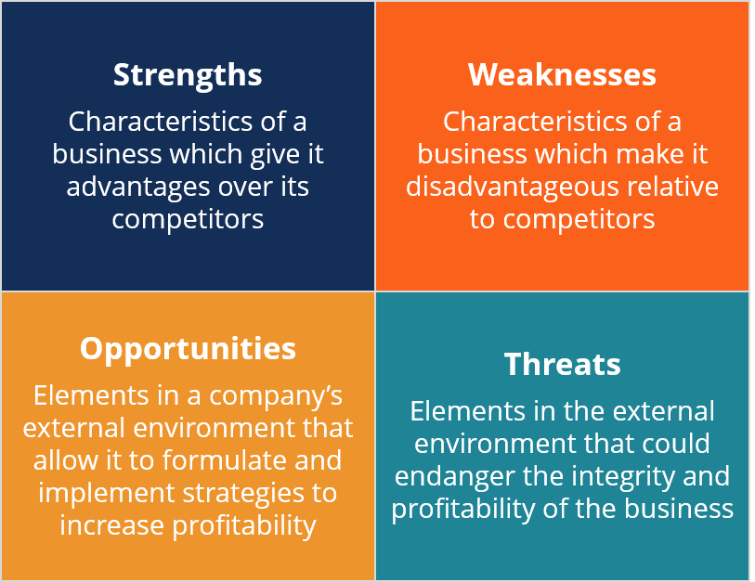
Broad Factors Analysis (PEST Analysis)
SWOT Analysis stands for Strengths, Weaknesses, Opportunities, and Threats. It can be a great way of summarizing various industry forces and determining their implications for the business in question.

Slide 44
Industry Analysis
1. Internal
Internal factors that already exist and have contributed to the current position and may continue to exist.
2. External
External factors are usually contingent events. Assess their importance based on the likelihood of them happening and their potential impact on the company. Also, consider whether management has the intention and ability to take advantage of the opportunity/avoid the threat.
Importance of Industry Analysis
Industry analysis, as a form of market assessment, is crucial because it helps a business understand market conditions. It helps them forecast demand and supply and, consequently, financial returns from the business. It indicates the competitiveness of the industry and costs associated with entering and exiting the industry. It is very important when planning a small business. Analysis helps to identify which stage an industry is currently in; whether it is still growing and there is scope to reap benefits or has reached its saturation point.
With a very detailed study of the industry, entrepreneurs can get a stronghold on the operations of the industry and may discover untapped opportunities. It is also important to understand that industry analysis is somewhat subjective and does not always guarantee success. It may happen that incorrect interpretation of data leads entrepreneurs to a wrong path or into making wrong decisions. Hence, it becomes important to collect data carefully.

Slide 45
competition analysis
understanding competition and analyzing competitors is a fundamental aspect of industry analysis. A thorough understanding of your competition and their role in the market is essential for making informed business decisions, identifying opportunities, and developing effective strategies. Here's how to analyze competition in your industry:
1. Identify Competitors:
Begin by identifying who your direct and indirect competitors are. Direct competitors offer similar products or services to the same target audience, while indirect competitors may serve the same needs but in a different way.
2. Competitor Profile:
Create detailed profiles for each of your competitors. Include information such as their size, market share, geographic reach, customer base, and key products or services.
3. Strengths and Weaknesses:
Analyze the strengths and weaknesses of each competitor. This could include factors like brand reputation, technology, pricing, distribution, customer service, and marketing strategies.
4. Competitive Positioning:
Determine how each competitor positions itself in the market. Are they known for quality, innovation, cost leadership, or some other distinctive factor?
5. Market Share:
Estimate the market share held by each competitor. This helps you understand the relative influence and dominance of each player.

Slide 46
competition analysis
6. Pricing Strategy:
Analyze the pricing strategies of your competitors. Are they pricing higher, lower, or at similar levels to your offerings? Understand the rationale behind their pricing.
7. Product and Service Offering:
Evaluate the range of products or services offered by your competitors. Identify any unique features or offerings that set them apart.
8. Customer Base:
Examine the customer base of each competitor. Do they target a specific demographic or market segment? Understanding their customer profile can help you identify gaps in the market.
9. Marketing and Branding:
Study the marketing and branding strategies of your competitors. Analyze their advertising channels, messaging, and brand reputation.
10. Distribution Channels:
Understand the distribution channels your competitors use to reach their customers. This may include direct sales, e-commerce, retail partnerships, or other methods.

Slide 47
competition analysis
11. Financial Health:
Review the financial health of your competitors, if possible. This includes factors like revenue, profitability, and growth trends.
12. SWOT Analysis:
Conduct a SWOT analysis for each competitor, highlighting their strengths, weaknesses, opportunities, and threats. This can provide a clear understanding of their competitive position.
13. Customer Feedback:
Gather feedback from customers of your competitors. This can provide insights into customer satisfaction, pain points, and areas where competitors may be falling short.
14. Market Response:
Monitor how competitors respond to market changes, trends, and emerging threats. This can reveal their adaptability and strategic agility.
15. Competitive Advantage:
Assess whether your business can gain a competitive advantage over your competitors. Look for opportunities to differentiate, innovate, or reduce costs to gain a competitive edge.
16. Develop a Competitive Strategy:
Based on your analysis, formulate a competitive strategy that addresses your competitors' strengths and weaknesses and positions your business effectively in the market.
Analyzing competition is an ongoing process as the market evolves. Regularly monitoring your competitors and adapting your strategies accordingly can help your business thrive in a competitive landscape. Understanding your competition is not just about identifying threats but also recognizing opportunities to excel and capture market share.

Slide 48
What Is an MVP?
MVP, or Minimum Viable Product, is a beta, or a test, version of your product or service.
When you decide to create customer-oriented software it's crucial to understand what the final users actually need.
In this sense, to make sure you have the necessary information and understanding of what your customer wants you’ll need to test your project– and this is where MVP comes in.
The term MVP (Minimum Viable Product) is a part of Lean Startup methodology, that aims to reduce waste, optimize business processes, and make startup smarter, not harder.
MVP is a perfect example of this methodology as it helps to reduce the cost and time waste of product launch while learning and optimizing the product in the process of development.
When you build an MVP, it helps you to know the balance between the company’s offer and customer’s needs. Through several cycles of testing, this will help you to minimize errors and optimize your ideas during the development process.

Slide 49
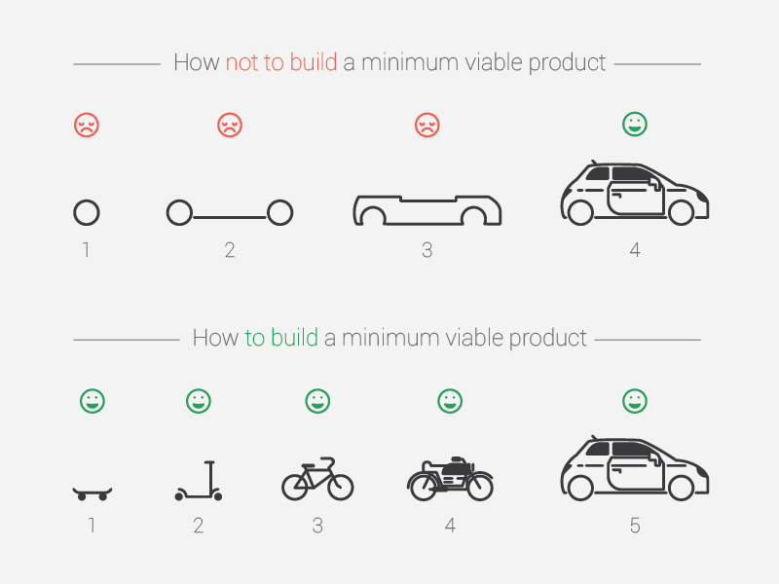

Slide 50
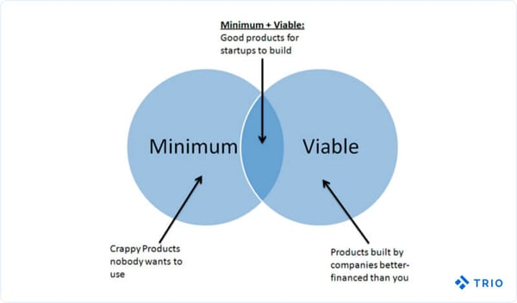

Slide 51
What Are the Main Benefits of an MVP?
The process of building an MVP drives a lot of benefits for companies in the process of software and application development.
Without developing an MVP you might face a larger initial investment in software development and a higher risk when it comes to releasing your product into the market.
MVP serves as a trial round that allows you to see your idea in action and make the necessary adjustments to make it more appealing and valuable to the user. If you launch your app, with a lot of features, it’ll be much harder to adjust in the future.
Also, the cost of building an MVP is much lower than a final version development, due to step-by-step development. Furthermore, when your app starts to bring some profit, you can reinvest it into the development of additional features.
At last, building an MVP can also work to attract investors. With a functioning product, you will have more chances to gather funds and attention from VCs or angel investors.

Slide 52
How To build an MVP: 5 Key Steps
Market research
Goal and main user identification
Choosing features that are most relevant for the user
Develop the MVP
Receiving the feedback and analyzing results

Slide 53
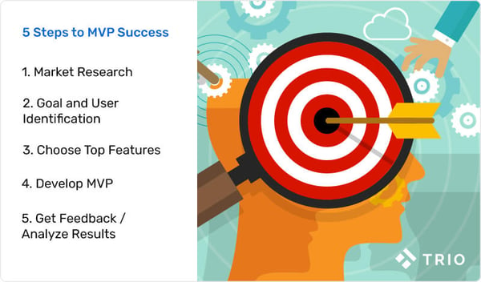
How To build an MVP: 5 Key Steps

Slide 54
How To build an MVP: 5 Key Steps
1. Market research
No matter how innovative and interesting your idea maybe, you need to do market research to assess demand and competitors to avoid significant financial and time losses.
Familiarize yourself with your target audience before you get to the product development stage.
Market research helps you to identify your ideal customers, what makes your idea unique and viable, what problems it may solve, and how to make your product meet your customer’s needs, before your even start to build an MVP.
Keep in mind that the key to successfully building an MVP is showing your target audience the value that your product will provide.
So during market research, it's crucial to decide how the user can benefit and how can you introduce the value to the customers.
2. Goal and main user identification
Establishing clear and specific metrics that will measure the launch success.
If you are developing an app, you can measure:
The number of downloads in a certain period of time
A total number of downloads
Review and feedback score
The time that users spend on the app
Anything else that helps you see if your MVP is meeting your customer’s needs or if it needs adjustment
Facts and statistics can provide you with a realistic viewpoint and helps identify clear goals and what success would look like.

Slide 55
How To build an MVP: 5 Key Steps
3. Choosing features that are most relevant for the user
Once you get a clear idea of what value you are bringing to users, your business goals, and how you combine these two points, it’s time to decide what your product will actually look like.
Think like the final user - mapping customer journeys provides you with information based on user behavior and helps you identify the sequence of actions that will solve the user's problem.
User journeys also include thoughts, feelings, and decisions that result in the user taking action. Journeys are a visual representation of the customer’s relationship with your product.
Remember to take into consideration what your users are thinking and feeling while using your product as it will considerably affect their decision-making process. You can also use this information to redirect them from one feature to another within the product.
To understand your user's journey answer the questions that identify users and their personality, decision-making process, the final goal, and a series of actions that users need to take to meet this goal.
If you define several types of potential customers, focus on the one that you can most quickly provide the most value. That will save you time when you analyze the test results.
At this stage of the development process, you need to define which features will be included in MVP and which will not. Focus on a smaller number that provides the most benefit to the user as the core of your product. These features have to solve the exact problems that you’ve identified earlier in your market in customer research.

Slide 56
How To build an MVP: 5 Key Steps
4. Develop the MVP
Now that you have all the necessary information it’s time to actually build an MVP.
The prototype should be user-friendly and engaging since it’s a representation of the final product you are looking to develop and by no means can it fall behind in quality standards.
Focus on the main features that will deliver the solution for users as fast as possible.
Once your prototype is released you can consider which feature will be the priority for developing the final version of the product.
5. Receiving feedback and analyzing results
I believe that measuring the results is the most important part of the MVP development process. This is the real test for the viability of your product and it will determine the future direction in final product development.
Listen carefully to what the users have to say. Even though you cannot satisfy every user in the market, user feedback can give you a very precise idea of the improvement of the features.
Modifying and tweaking are part of the development process of your product and you need to be prepared to adjust your product to the market needs.
You may need to run tests with adjustments several times before you are ready to develop the final product.
Adjusting and optimizing MVP for tests may seem like an unnecessary step but it gives you an opportunity to adapt the product perfectly to customer needs which can result in higher engagement and profit when the final version is released.

Slide 57

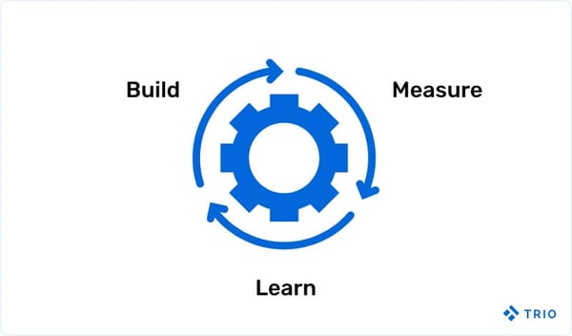
MVP Development
is the
Best Process for Idea Validation

Slide 58
Features of MVP
MVP should be focused on a single buyer persona. It works well when intended to solve the problems of one individual. You should always avoid building for multiple audiences.
It should be easy to build and facilitate a faster launch.
Despite building the MVP for a single individual, you should take into consideration several feedback. It is quite likely that diverse reviews can resolve most of the issues.
Take the feedback more seriously if the reviewer fits into the target audience of your product.
The minimalism of MVP does not imply that you expect more by putting in less efforts. It should highlight the problems that can be solved with the app and how it can do so.
www.techtic.com | info@techtic.com

